Slide 1


Porter Stemmer: Applications and Use Cases
SIMATS ENGINEERING
SAVEETHA INSTITUTE OF MEDICAL AND TECHNICAL SCIENCES
Presented by:
Name: Ch Haritha
Reg No: 192425280
DSA0304 – Natural Language Processing

Slide 2
Introduction
Porter Stemmer is a rule-based algorithm used in Natural Language Processing (NLP) to reduce words to their root or base form.
It was developed by Martin Porter in 1980 and is one of the most widely used stemming algorithms for English text.
The algorithm removes common suffixes such as -ing, -ed, -ly, and -s, making text processing faster and more efficient.
Porter Stemmer helps reduce the number of unique words in a document, improving tasks like search engines, text mining, information retrieval, and sentiment analysis.
Due to its simplicity, speed, and effectiveness, Porter Stemmer remains an important preprocessing technique in many NLP and machine learning applications.

Slide 3
Working Mechanism
1Input Text: The algorithm receives a sentence or document as input for processing.
Tokenization: The input text is split into individual words (tokens).
Apply Stemming Rules: Porter Stemmer applies predefined rules to remove common suffixes such as -ing, -ed, -ly, -es, and -s.
Generate Stem Words: After removing suffixes, each word is converted into its root (stem) form. Example: Playing → Play, Connected → Connect, Studies → Studi.
Output Stemmed Text: The final stemmed words are used in NLP applications like search engines, text mining, information retrieval, and sentiment analysis.

Slide 4
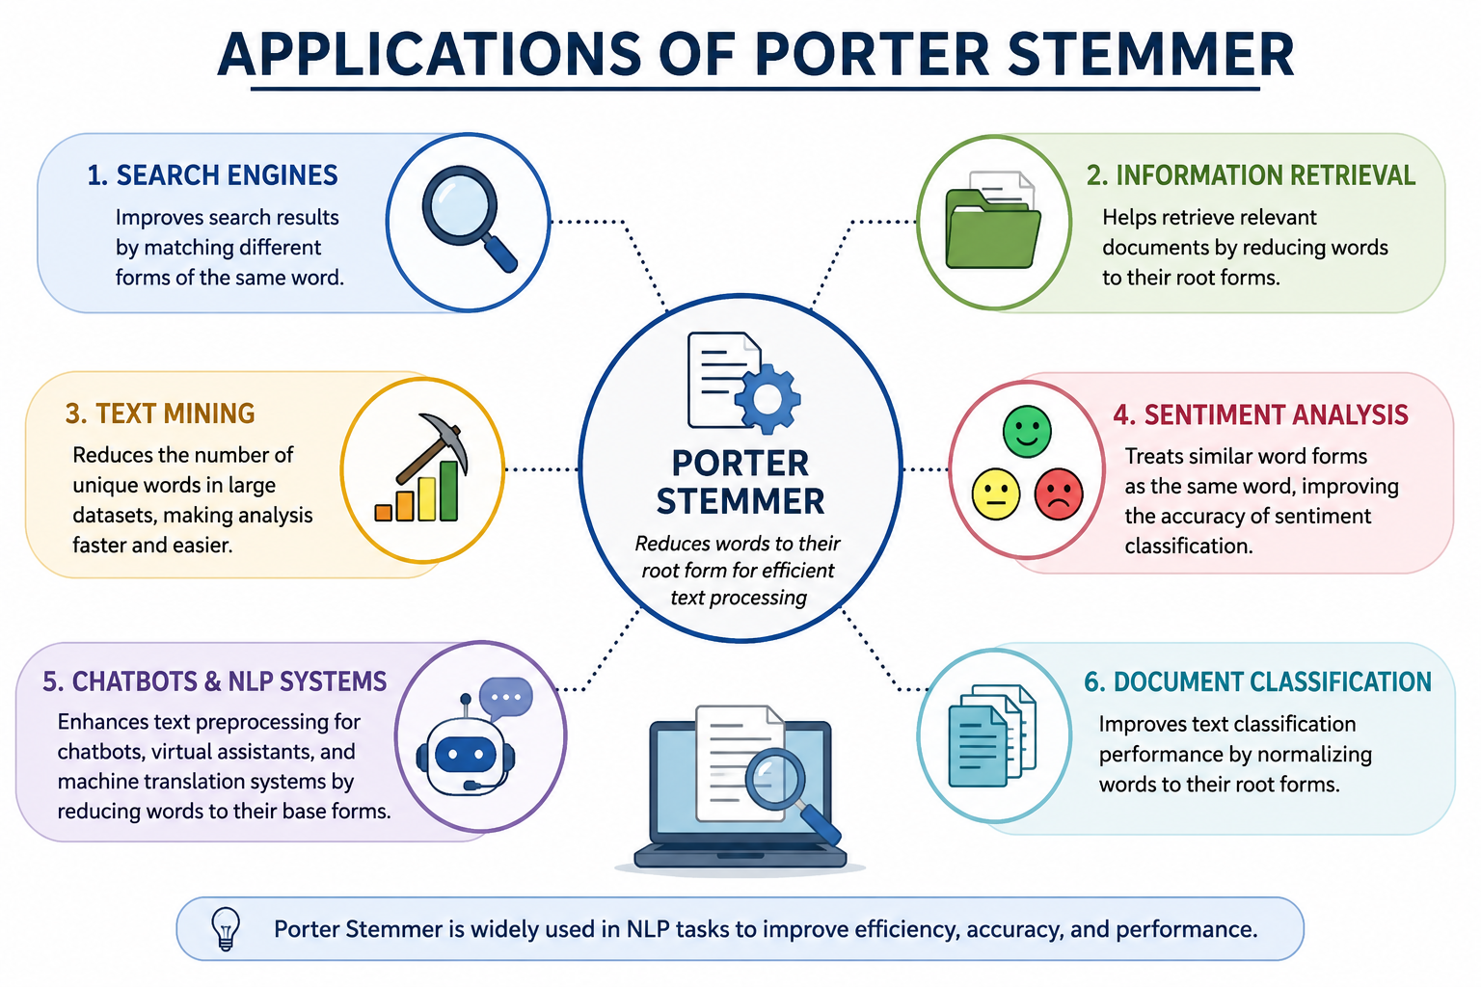

Slide 5
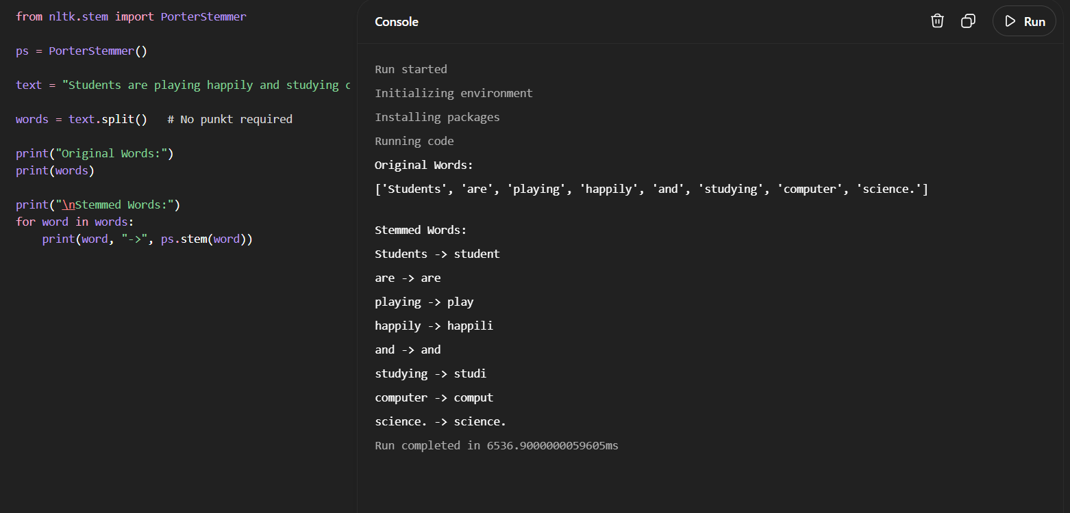
Code Implementation
from nltk.stem import PorterStemmer
ps = PorterStemmer()
text = "Students are playing happily and studying computer science."
words = text.split() # No punkt required
print("Original Words:")
print(words)
print("\nStemmed Words:")
for word in words:
print(word, "->", ps.stem(word))

Slide 6


